Slide 1
KCM1202ob Coffee Maker Redesign
By: Lester Tang, Samuel Yeung, Kureishi Shivanand, Anton Suprun, Yassin Ali

Slide 2
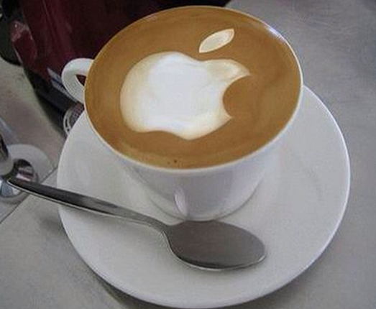
Design Impacts
Coffee is more than a Drink

Slide 3

Design Impacts
Communication matters

Slide 4
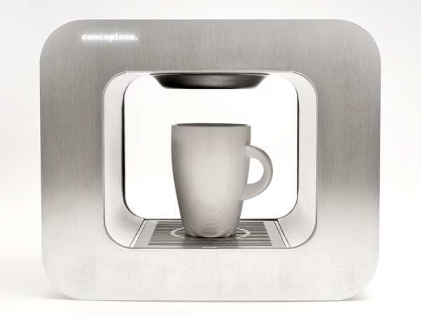
Design Impacts
Design is a vehicle for communication

Slide 5
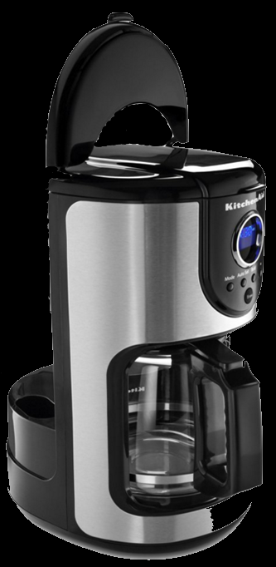
Technological Impacts
Sensor needs to fit into the bottom of the carafe
Sensor technology already known
Load cell sensors and force sensors
can measure force

Slide 6
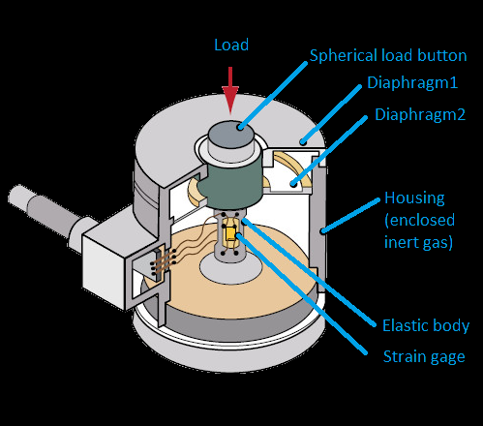
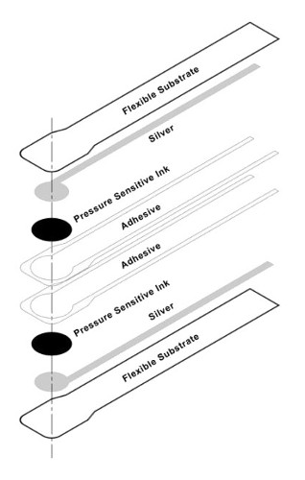
Costs & Availability
Sensors need to be:
Small
Common
Cheap
Each sensor has their own advantages
And disadvantages

Slide 7
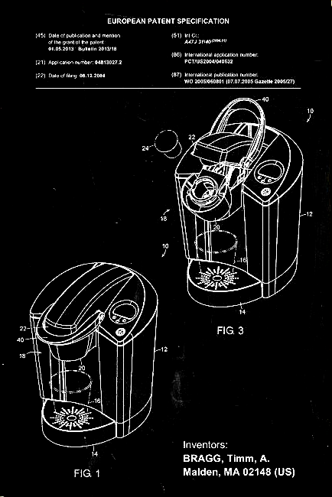
Patents
Design may conflict with existing patents
Many sensory patents already exist
Patent process consists of
13 detailed steps

Slide 8
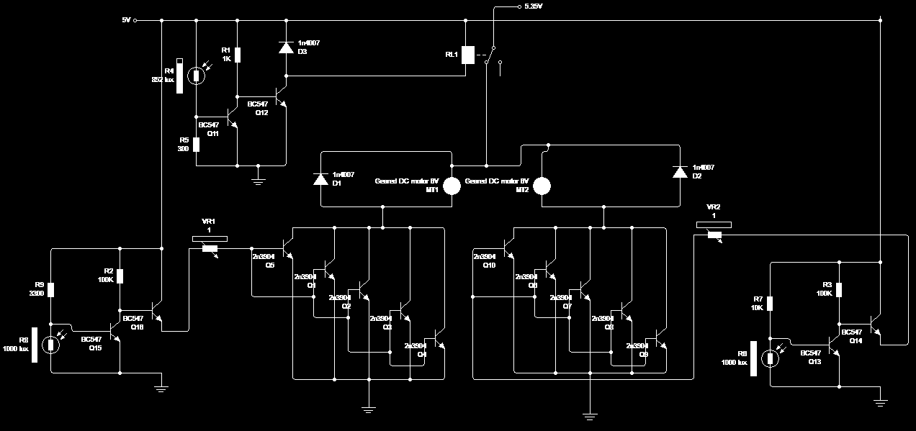
Implementation Impacts
Information already known
No need to waste time

Slide 9
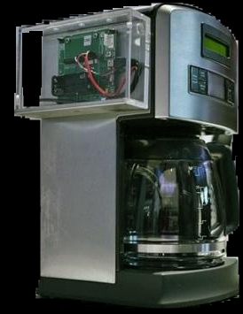
Prototyping & Testing
Re-Design new machine base
Ensure good reaction time
Able to sense the weight of carafe

Slide 10
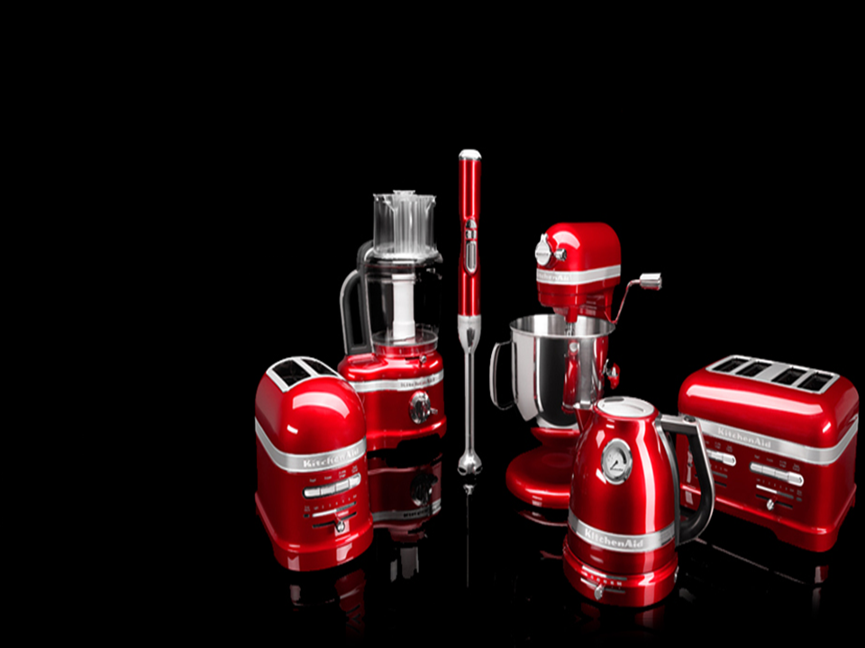
Finishing Touches
Focus should be on:
Design costs
Visual Appeal
Production and delivery are easily dealt with

Slide 11


End User Impacts
Pros:
Safer, cleanlier experience
Stronger user interface
Cons:
Price increase for new design
Change to frame size

Slide 12
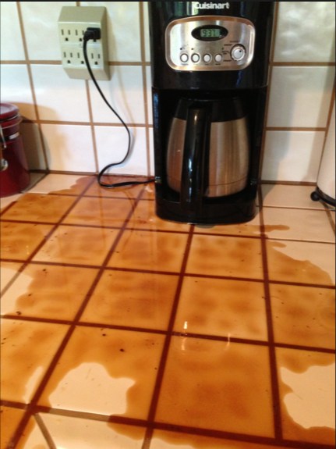
Safety
Sensor operates on low
power
Designed to prevent hazardous spills

Slide 13
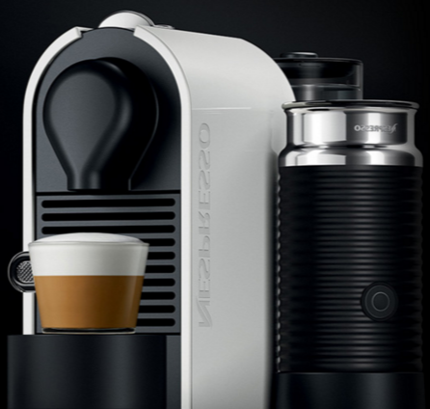
Innovations in Coffee Making
Designs are becoming more user-friendly
Better brew for less work
More coffee variety
14 cups at the touch of a button

Slide 14
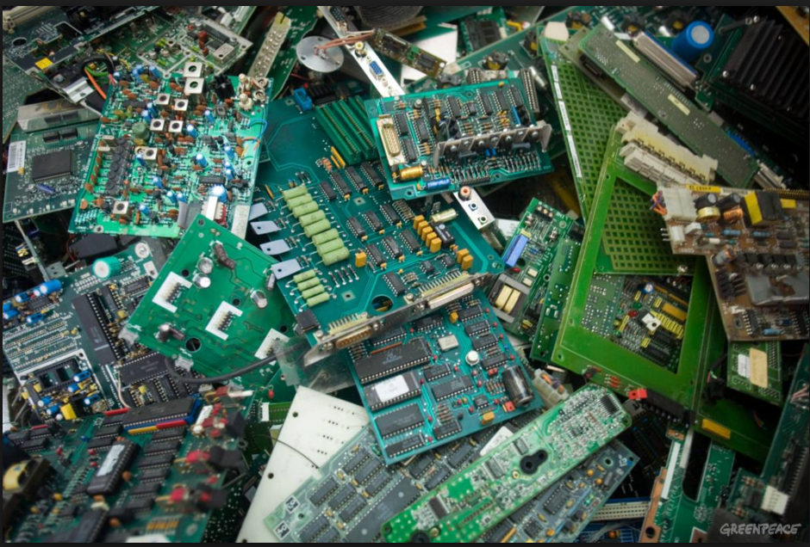
Electronic Waste
41.8 million metric tonnes of
electronic waste was
generated in 2014
12.8 million tonnes is
composed of small
electronic equipment

Slide 15
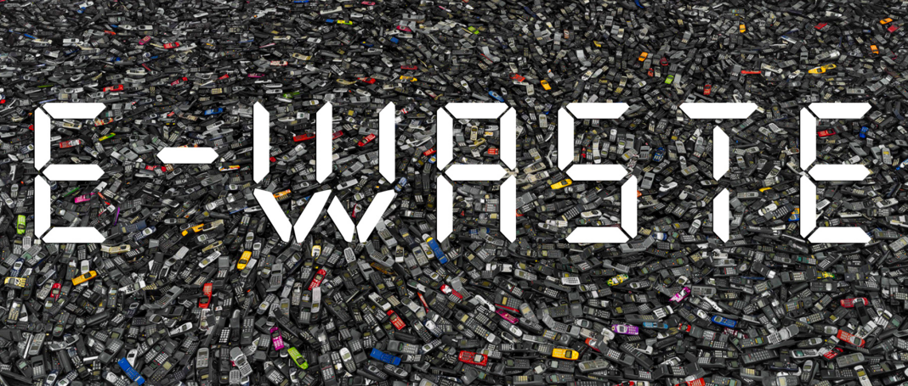
Electronic Waste
1 in 3 households in
North America own
a coffee maker
Adding a sensor to a coffee maker will have almost negligible effect on the amounts of electronic waste

Slide 16

Electronic Waste
Sensors can be salvaged, recycled and reused

Slide 17
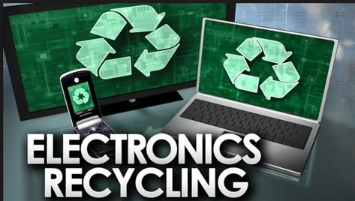
Sensor Production
Recycled materials can be used in order to produce the sensor
This will reduce its
impact on the
environment

Slide 18
References
http://www.ni.com/white-paper/13654/en/#h36
https://www.google.com/patents/WO2010089715A1?cl=en&dq=coffee+maker+sensor&hl=en&sa=X&ved=0ahUKEwjXiYHV2c3LAhXKs4MKHYWmAjgQ6AEIHTAA
https://www.tekscan.com/resources/ebook/load-cell-vs-force-sensor
http://www.uspto.gov/patents-getting-started/patent-basics/types-patent-applications/utility-patent/patent-process-0
http://www.uspto.gov/patents-getting-started/patent-basics/types-patent-applications/nonprovisional-utility-patent
http://globalnews.ca/news/2194391/electronic-waste-is-piling-up-heres-why-you-should-care/
http://www.workaci.com/pdf/technotes/pressure_technical_notes.pdf

